Slide 1

Trauma Kit for Bullying
Maria K. Ferguson
November 16, 2021

Slide 2
Bullying
A Definition - Bullying
Ongoing, deliberate misuse of power in relationships through repeated verbal, physical and/or social behavior and results in adverse childhood experiences, which affect life or health.

Slide 3
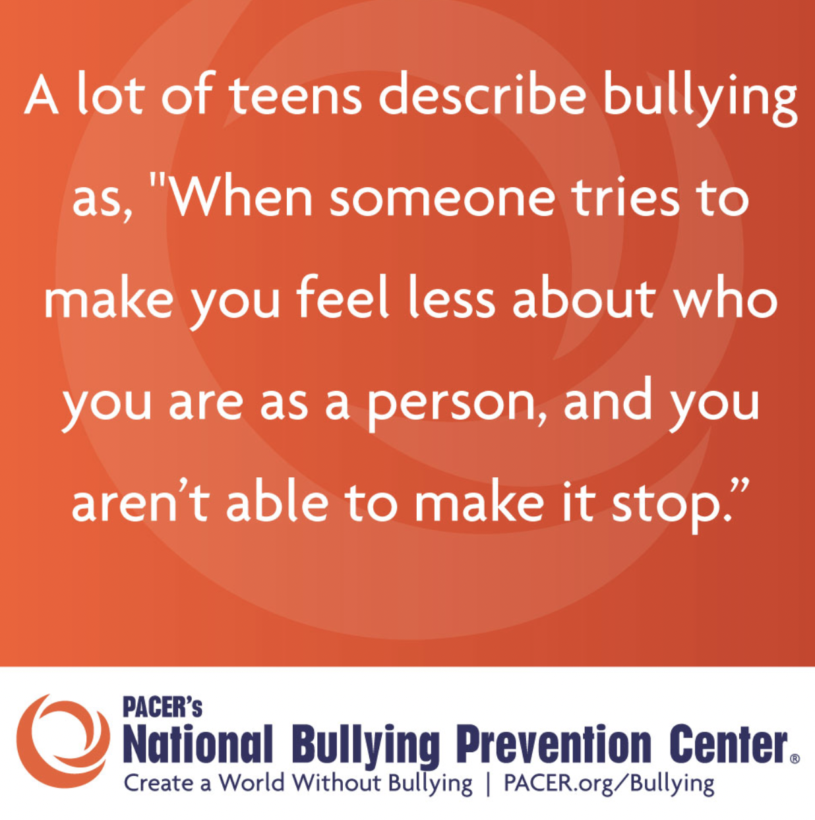
https://pacerteensagainstbullying.org/wp-content/uploads/2014/04/bullying-defined-quote1.jpg

Slide 4
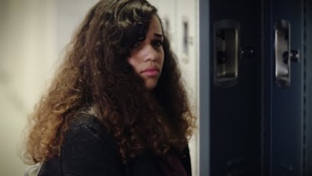
Activity #1– Watch and discuss:
Have you been a victim of Bullying? Watch this video for an example.
A young lady wakes up one morning and checks her phone messages before going to school. At school, she feels isolated, and other kids seem to avoid her. She starts getting rude messages on her phone. On the way home, she is surrounded by a group of girls from her school who begin to push her around. Another girl intervenes and says “Amanda, STOP, She’s done nothing to you!”.

Slide 5
Quiz in response to video:
Have you ever seen someone who was publicly bullied?
Yes – I have seen this happen and wanted to help the bullied person but didn’t.
Yes – I have seen this happen but felt too weak to help them; I didn’t want to get involved.
Yes – I have seen this happen and I sided with the bully.
Yes – I helped the person who was bullied
No – I’ve never seen this happen
There are reasons why people make a wrong decision.
The best way to resolve that is not being an inactive bystander.
DON”T TOLERATE BULLYING – REPORT IT.

Slide 6
What should I do if I am bullied?
https://www.stopbullying.gov/resources/kids#bullied
There is help – hang in there.

Slide 7
What to do:
1. Tell someone you trust about the experience
2. To prepare for a run-in with the bully again, do not show emotion when they approach you, specifically fear. They thrive on it.
3. Show confidence in yourself, stand up straight and look them in the eye.
4. Try to make friends with the other students, if you can. If there is a group of them and this is not possible, be confident in yourself anyway. It takes more of them to stand up to you!!
5. Avoid situations where you will run the risk of it happening again.
6. Do not carry any weapon or resort to aggression yourself. GET HELP FROM AN ADULT.
7. Build up your self-esteem. Become active in activities or hobbies.

Slide 8
”Safe Haven”, Trauma-REady
Go to a Safe Place – this is a place where the victim may be taken for Trauma-Informed care from a nurse, social worker, teacher, or other adult.
. A self-made trauma kit may be put together to help with grounding; these may contain the following:
a) Music that is to their liking and delivers a positive message – possibly through an ipad with headset.
b) A snack that they like
c) Something that they can do with their hands. My nephew loves modelling clay. Other people would prefer a magazine – a variety of different things can be kept on hand.
3. Trauma-Informed care may take place and it would be necessary to make the room comfortable.

Slide 9
Parents or guardians
https://www.stopbullying.gov/prevention/on-the-spot

Slide 10
Intervene immediately. It is ok to get another adult to help.
Separate the kids involved.
Make sure everyone is safe.
Meet any immediate medical or mental health needs.
Stay calm. Reassure the kids involved, including bystanders.
Model respectful behavior when you intervene.
What a Parent or guardian can do

Slide 11
AVOID THESE COMMON MISTAKES
Don’t ignore it. Don’t think kids can work it out without adult help.
Don’t immediately try to sort out the facts.
Don’t force other kids to say publicly what they saw.
Don’t question the children involved in front of other kids.
Don’t talk to the kids involved together, only separately.
Don’t make the kids involved apologize or patch up relations on the spot.

Slide 12
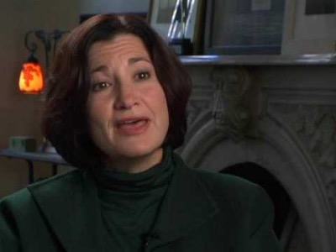

Hazing Video – for parents, educators, teachers
This is a special case of Bullying that occurs in groups such as sports teams, military, some fraternities/sororities, workplaces, and other groups where there are initiations or rallying of some sort.
Breathe Nolan, Breathe – CAUTION- not for children to watch

Slide 13
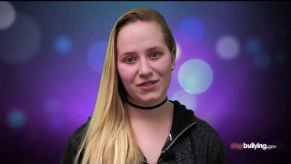
Bystanders
Become Upstanders

Slide 14
Did you see someone get Bullied?
1.Talk to an adult that you trust
Adults, parents, teachers, or other adults need to know when bad things happen so they can help.
2. Be kind to the kid being bullied.
Try to include them. Just hanging out with them will help them know they aren’t alone.
Not saying anything could make it worse for everyone.
The kid who is bullying will think it is ok to keep treating others that way.

Slide 15
Prevention of Bullying
Don’t allow it, don’t participate in it, and definitely report it!
Don’t fuel the perpetrator(s)!!!!!

Slide 16
There are several types of bullying.
Generally, bullying can be:
Physical –hitting, blocking, pinching, pushing, stealing, damaging property – short- and long-term damage is done
Verbal – name calling, insults, teasing, intimidation, verbal abuse, ethnic or sexual innuendos
Social – also called Covert Bullying – designed to hurt someone’s social reputation or cause humiliation.

Slide 17
Social Bullying
Can include:
1.Lying about a person and spreading rumors, or gossiping about them
2. gestures, facial expressions, menacing looks
3. Playing jokes on people to embarrass or humiliate them
4. Encouraging others to socially exclude someone
5 Damaging someone’s reputation socially or politically
6. Damaging someone’s social acceptance, or covertly drawing people away from someone

Slide 18
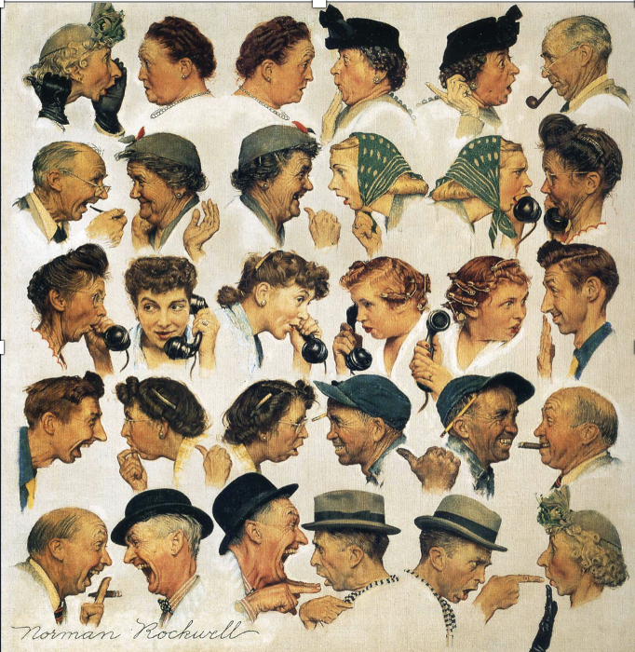
BULLYING ACTIVITY #2
Classroom activity:
Discussion: What does this famous painting portray?
Alternate activity: Write a paragraph about what is going on in this picture.
What is the significance?
What is the difference between the people at the top, and what is different at the bottom?

Slide 19
ROLE PLAYING – ACTIVITY #3
Role Play
HAVE STUDENTS CHOOSE THE FOLLOWING ROLES . CHOOSE STUDENTS TO PORTRAY ONE OF THE ROLES IN A ONE-ACT PLAY.
Whole Class
IF THERE ARE SEVERAL STUDENTS, THEN THE CLASS CAN BE BROKEN INTO GROUPS, AND EACH GROUP ROLL-PLAY A SCENARIO OF THEIR OWN.HAVE THE STUDENTS ACT OUT THEIR ONE-ACT PLAY FOR THE WHOLE CLASS.
Follow-up
FOLLOW WITH A DISCUSSION OF THE VARIOUS SCENARIOS THAT WERE ACTED OUT - THE RESULTS WILL BE INTERESTING BECAUSE THEY WILL COME UP WITH SOME SCENARIO’S THAT ARE REAL AND THINGS THAT THEY KNOW CAN OR DO HAPPEN.

Slide 20
THE ROLES
1. VICTIM: A member of the class who is not the most popular kid on the planet, gets along pretty will – they are just not that cool. They seem to be the victim often and is left out and often gossiped about.
2. BYSTANDER: Another kid in the class, someone popular, just caught at the wrong place at the wrong time.
3. PERPETRATOR 0R BULLY- always wants and needs the attention of the other students, is popular and likes to get groups to form his or her own club – often picking on people who don’t join or agree on everything they do.
4. OTHERS that don’t pick a role will be bystanders, parent, teacher, police, coach, or a bully in a group of bullies
OPTIONAL WRITING PROMPT
THE STUDENTS WILL WRITE A REFLECTION ON ONE OF THE ONE-ACT PLAYS THAT WAS ACTED OUT BY THEIR CLASS ON THE ‘EFFECT OF BULLYING’.

Slide 21
Effects on bullying can be life-long
As a review, bullying is the systematic abuse of power and is defined as
aggressive behavior or intentional harm-doing by peers that is carried out
repeatedly and involves an imbalance of power. (US National Library of Medicine/ National Institute of Health website: https://www.ncbi.nlm.nih.gov/pmc/articles/PMC4552909/)
Children who are bullied-and especially those who are frequently bullied-continue to be at risk for a wide range of poor social, health, and economic outcomes.
Interventions need to reduce bullying exposure in childhood and minimize long-term effects on victims' well-being.

Slide 22
Resources and more references on bullying
You may have to copy and paste into a browser the websites below:
Religious resources: others may be available, but very interesting sources and interviews:
https://www.catholicregister.org/faith/homilies/item/26630-bullying-is-the-devils-work-pope-says
https://vimeo.com/29742955?utm_campaign=5370367&utm_source=affiliate&utm_channel=affiliate&cjevent=3ffa4180440511ec83c0cb1b0a82b832&clickid=3ffa4180440511ec83c0cb1b0a82b832
https://www.insidehazing.com/dr-lipkins (Psychologish Dr. Susan Lipkin)
https://youtu.be/WZrqrzG3UA8. (”Breathe Nolan, Breathe”)
https://thecatholicassociation.org/human-dignity/
https://www.vatican.va/content/john-paul-ii/en/messages/peace/documents/hf_jp-ii_mes_08121994_xxviii-world-day-for-peace.html
(This is Pope John Paul II’s letter on ‘Women as Teachers of Peace in Society”)
https://www.linkedin.com/pulse/20140808184332-12571684-gossip-the-most-insidious-form-of-bullying
Values Coach John Tye on “Gossip: the Most Insidious Form of Bullying”

Slide 23
More Resources and references on bullying
“Bullying Behaviors Among U.S. Youth,” Journal of the American Medical Association 285
https://www.ncbi.nlm.nih.gov/pmc/articles/PMC2435211/
Factsheets for adults:
https://njbullying.org/documents/whatweknowaboutB.pdf
https://educateiowa.gov/sites/files/ed/documents/tip%20sheet%20misdirections%20in%20bullying%20prevention.pdf
For teens
http://www.ncdsv.org/images/nyvprc_factsforteensbullying.pdf
https://www.healthforteens.co.uk/feelings/bullying/cyber-bullying-just-the-facts/
https://www.healthforteens.co.uk/health/coronavirus/how-to-make-yourself-a-calming-kit/
https://www.pacer.org/bullying/

Slide 24
More Resources and references on bullying
Activity
https://www.pacer.org/bullying/classroom/middle-highschool/what-should-you-do.asp
APA Policy (American Psychological Association
https://www.apa.org/about/policy/bullying.pdf
Many activities, posters and flyers are available from StopBullying.gov:
https://www.pacer.org/bullying/classroom/middle-highschool/

Slide 25
Don’t Full Bullies-
Report them!

