Slide 1

Apps Assignment
SED 118 Principles of Instructional Technology
Maria K. Ferguson, October 26, 2021

Slide 2
For the Parents
PhET Sims - Science/Math
CK12 –Science Resources
Cybercivics, a Digital Citizenship ’curriculum’ for parents
Bark, a Parental Control App
Khan Academy
Notes:
Five apps were chosen that can be used by parents of school age children. I evaluated each app with the ”App evaluation Rubric”. Then these apps were compared with each other using the Seton Hill lesson plan rubric.

Slide 3
APPS For Teachers
PhET – Science/Math
CK-12 Science Resource
Explain Everything
Labster
Because Learning!
Notes:
Five apps were also chosen for Teachers to use in teaching their curriculum. I focused on apps that could be used to teach Science. Each app was evaluated by using the “App Evaluation Rubric”. Then all the apps were also compared using the Seton Hill lesson plan Rubric

Slide 4
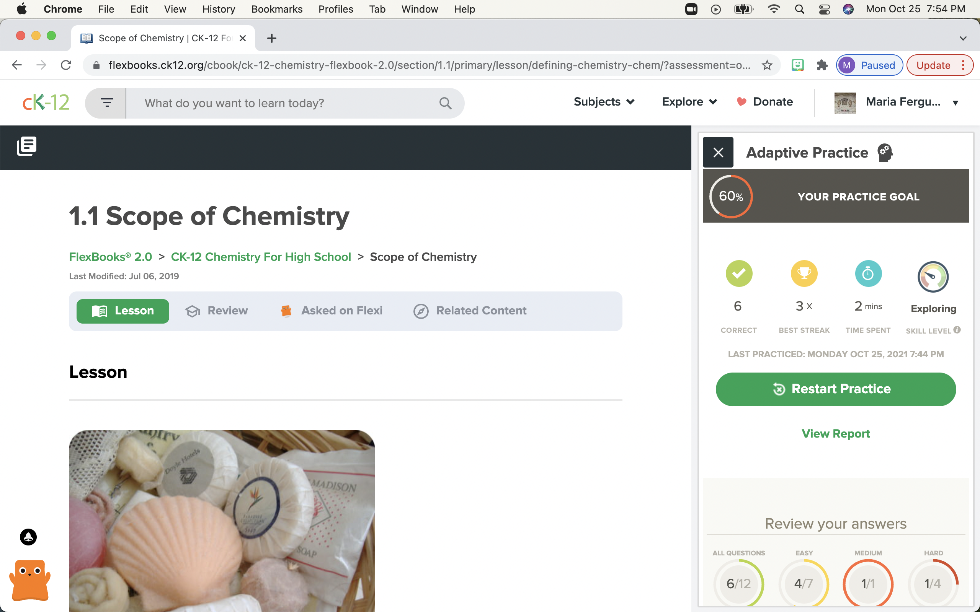
PhET – Simulations for SCIENCE/MATH
Students and parents can explore many Science topics by using over 100 simulations
Notes:
This is a collaborative effort, of the University of Colorado (which has 94 financial sponsors worldwide), with the goal to provide students with an open, exploratory environment through which they can learn many science and math topics.
Utilizes Interactive Simulations
Free to use and to download for each Simulation
Here, it is showing an introductory Chemistry Lesson, the Scope of Chemistry. On the right is an interactive quiz.

Slide 5
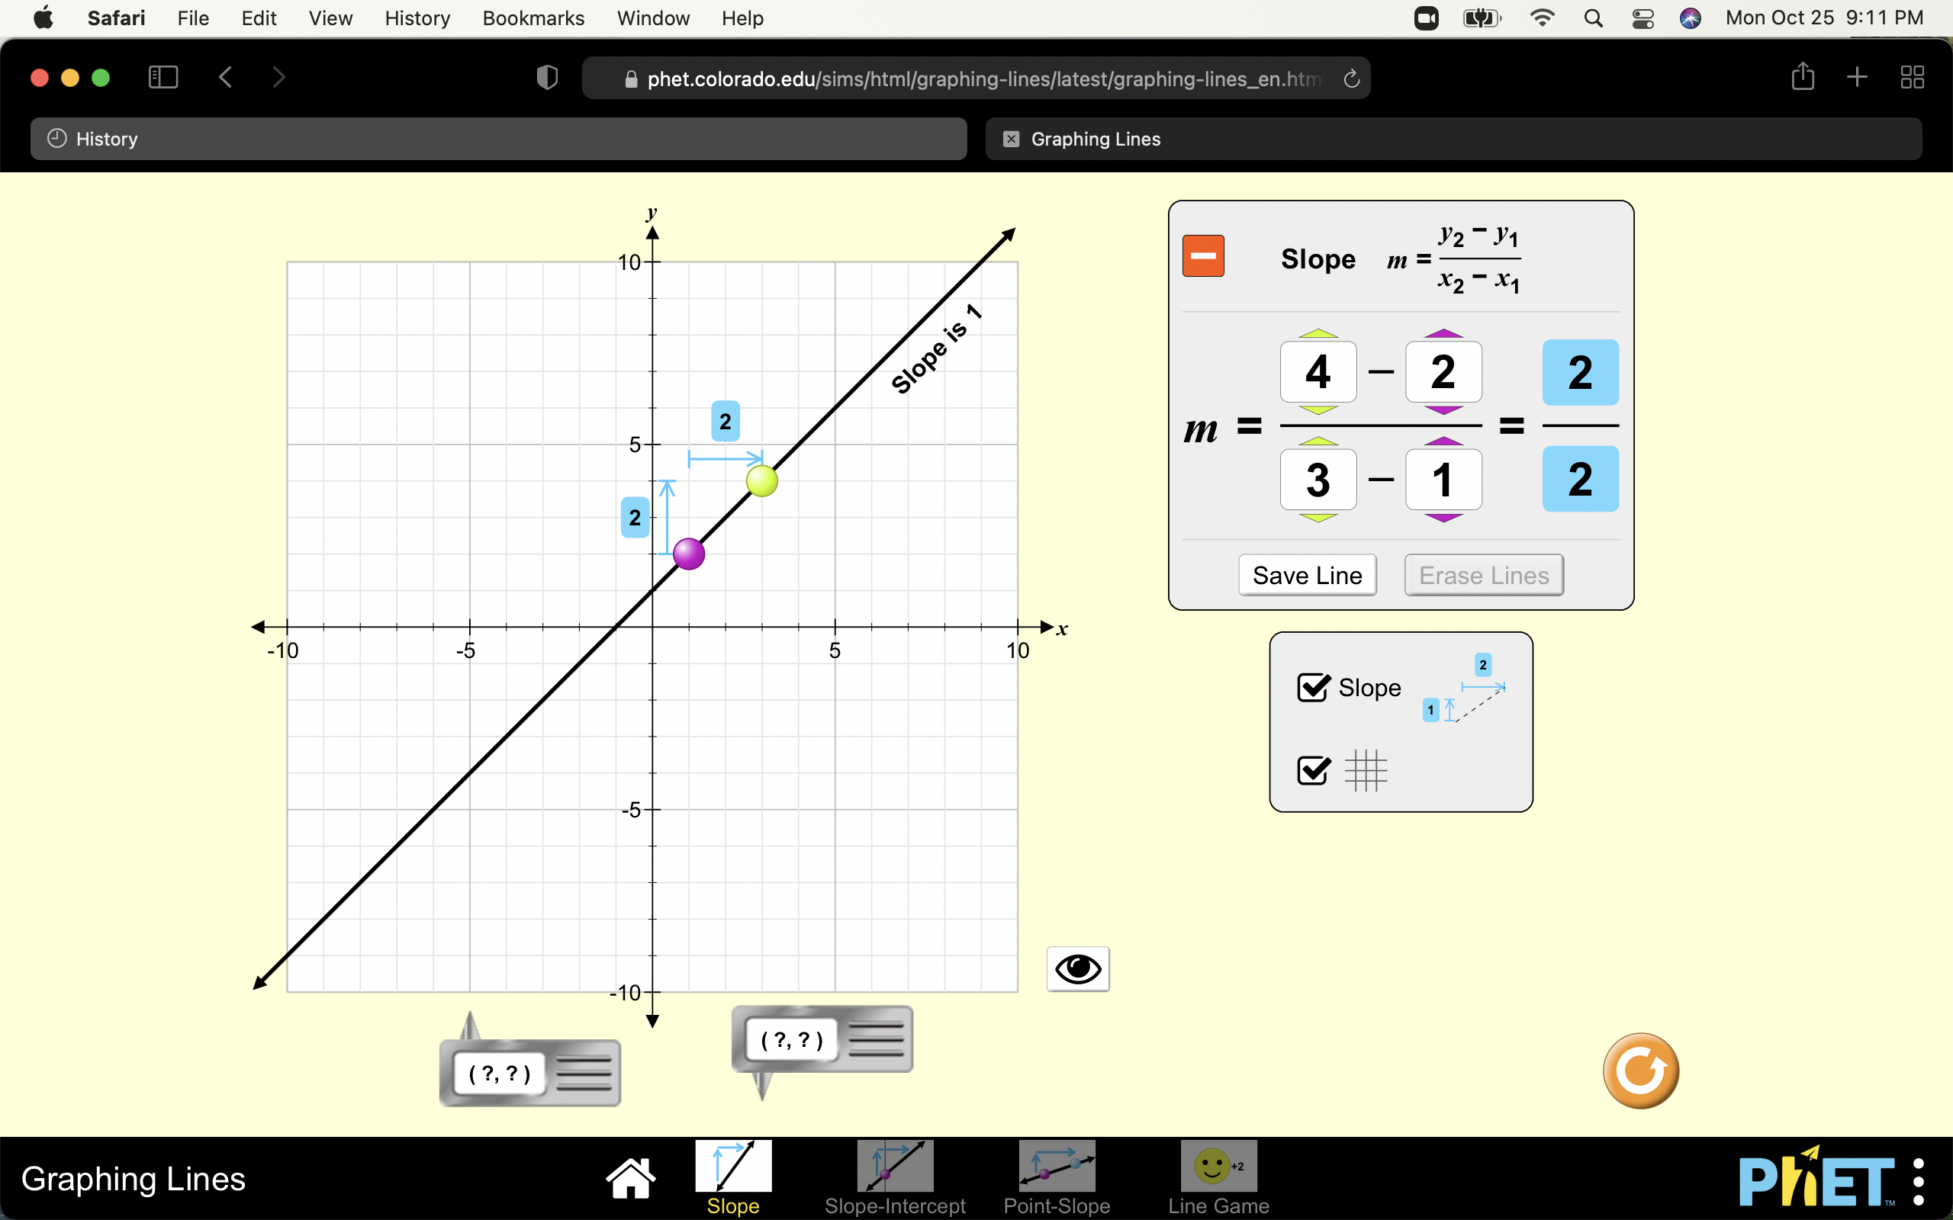
Phet –Science/Math, continued
Math example
SLOPE calculations
Useful for any subject
Notes:
A small sample which is useful for any subject at the high school level, is SLOPE. The slope of a graphed line can be computed. You can predict how changing variables in a linear equation will affect a graphed line.

Slide 7
CK-12 Science Resources
Can become certified to use the CK-12 resources to help their student and utilize the technology/app as a homeschool parent
Can do webinars
Can certify at their own pace
Can ”create a class” and monitor activities, can use Google Classroom, Canvas or Schoology or Braingenie
Can create quizzes

Slide 8
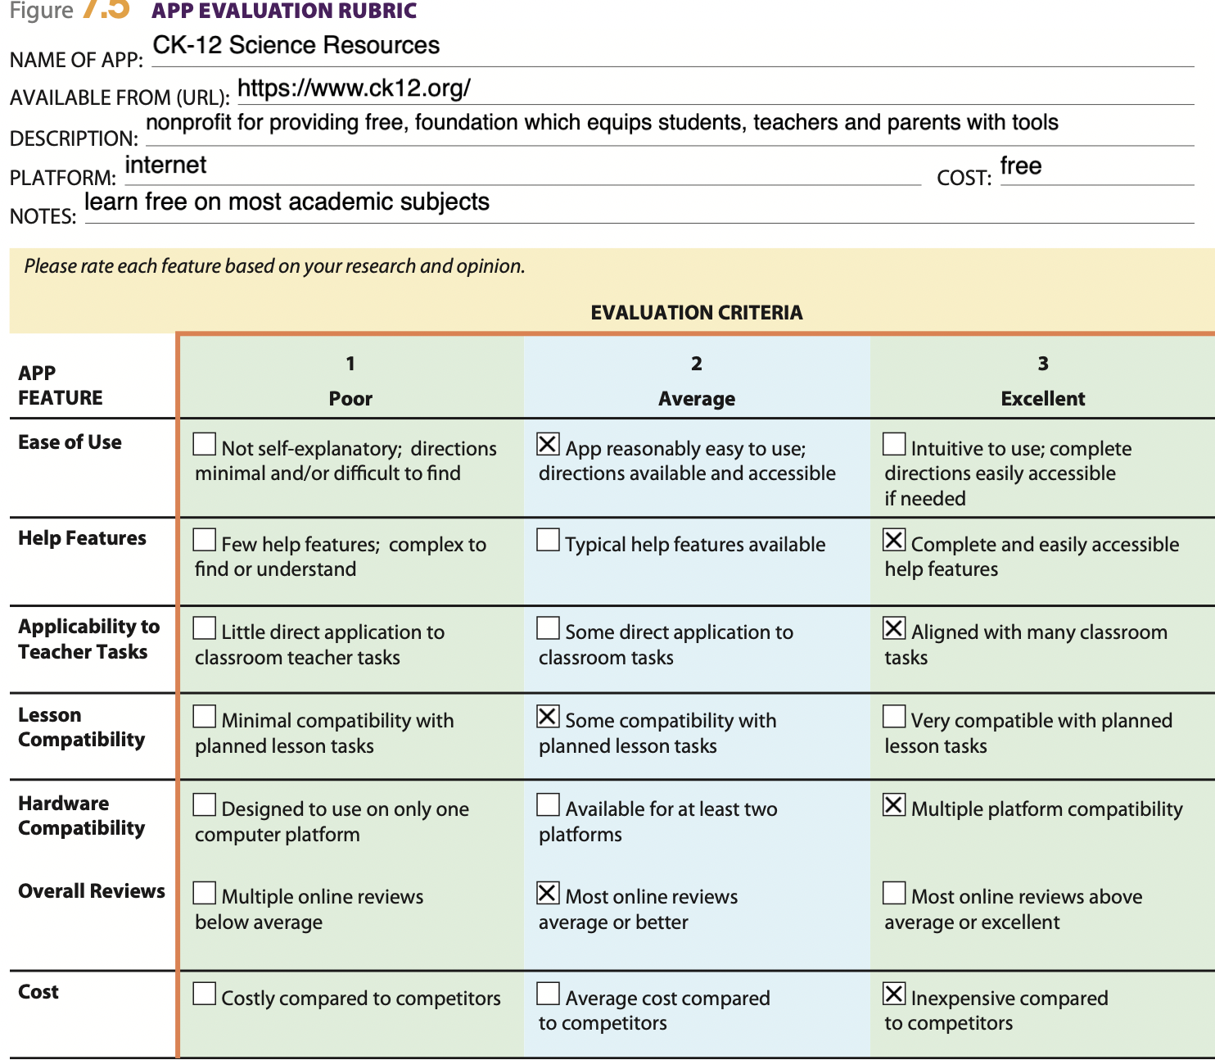

Slide 9
CyberCIVICS
A ”Digital Citizenship” curriculum which can be used for homeschoolers
Teaches ethical and productive computer use
Teaches information literacy, so is basically teaching computer usage
Teaches media literacy, which is important when searching for news and information on the internet. There is a lot of “fake news” out there
My impression is that it is essential to have Digital Citizenship and this is a full course. There are free lessons to try, but it requires entering your email address.

Slide 10
Cybercivics tools
The book in use is “Raising Humans in a Digital World: Helping Kids Build a Healthy Relationship With Technology” by Diana Graber.
  It explains how Digital Citizenship started and helps parents understand what skills students need the most.
  It includes activities that parents can do with their kids.
Zoom Webinars with the author
Educator Workshops with an instructor

Slide 11
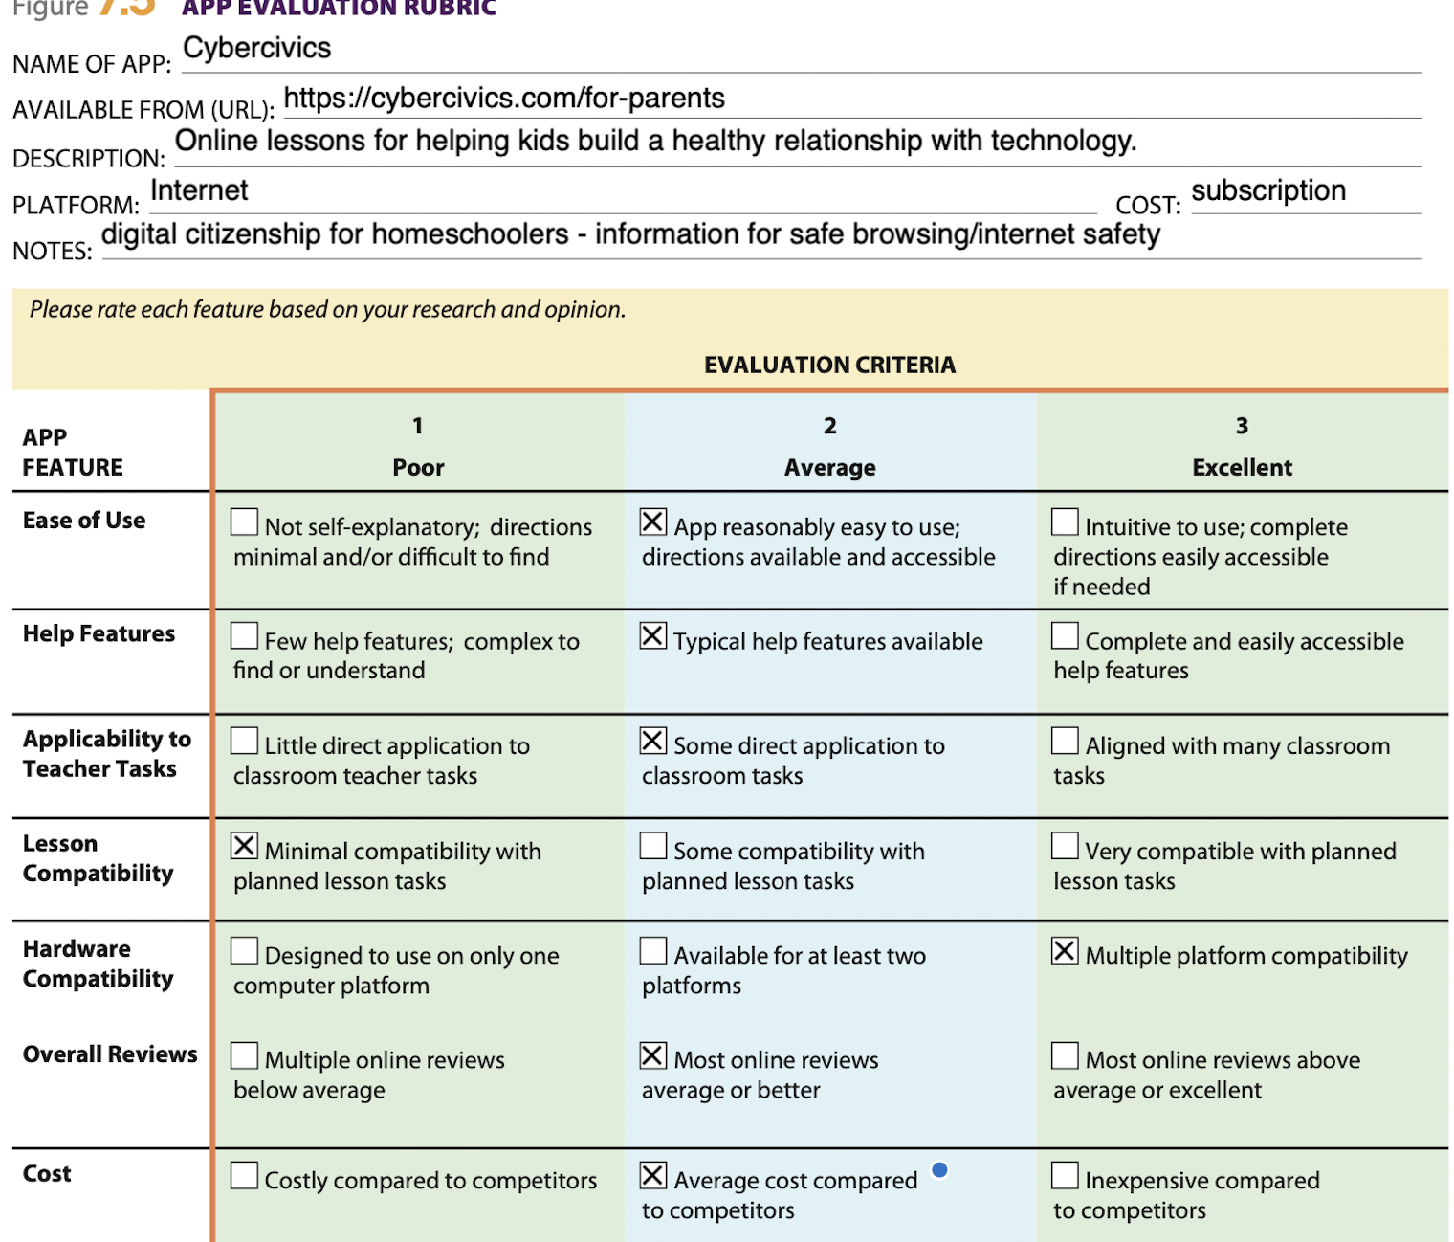

Slide 12
Bark and Bark, Jr.
Parental Control App
Can monitor Social Media Apps of family
Can monitor digital safety of school accounts
Can manage websites your students access
Has free ”Bark Jr” to give every family screen time controls
The starting price is $60/year.

Slide 13
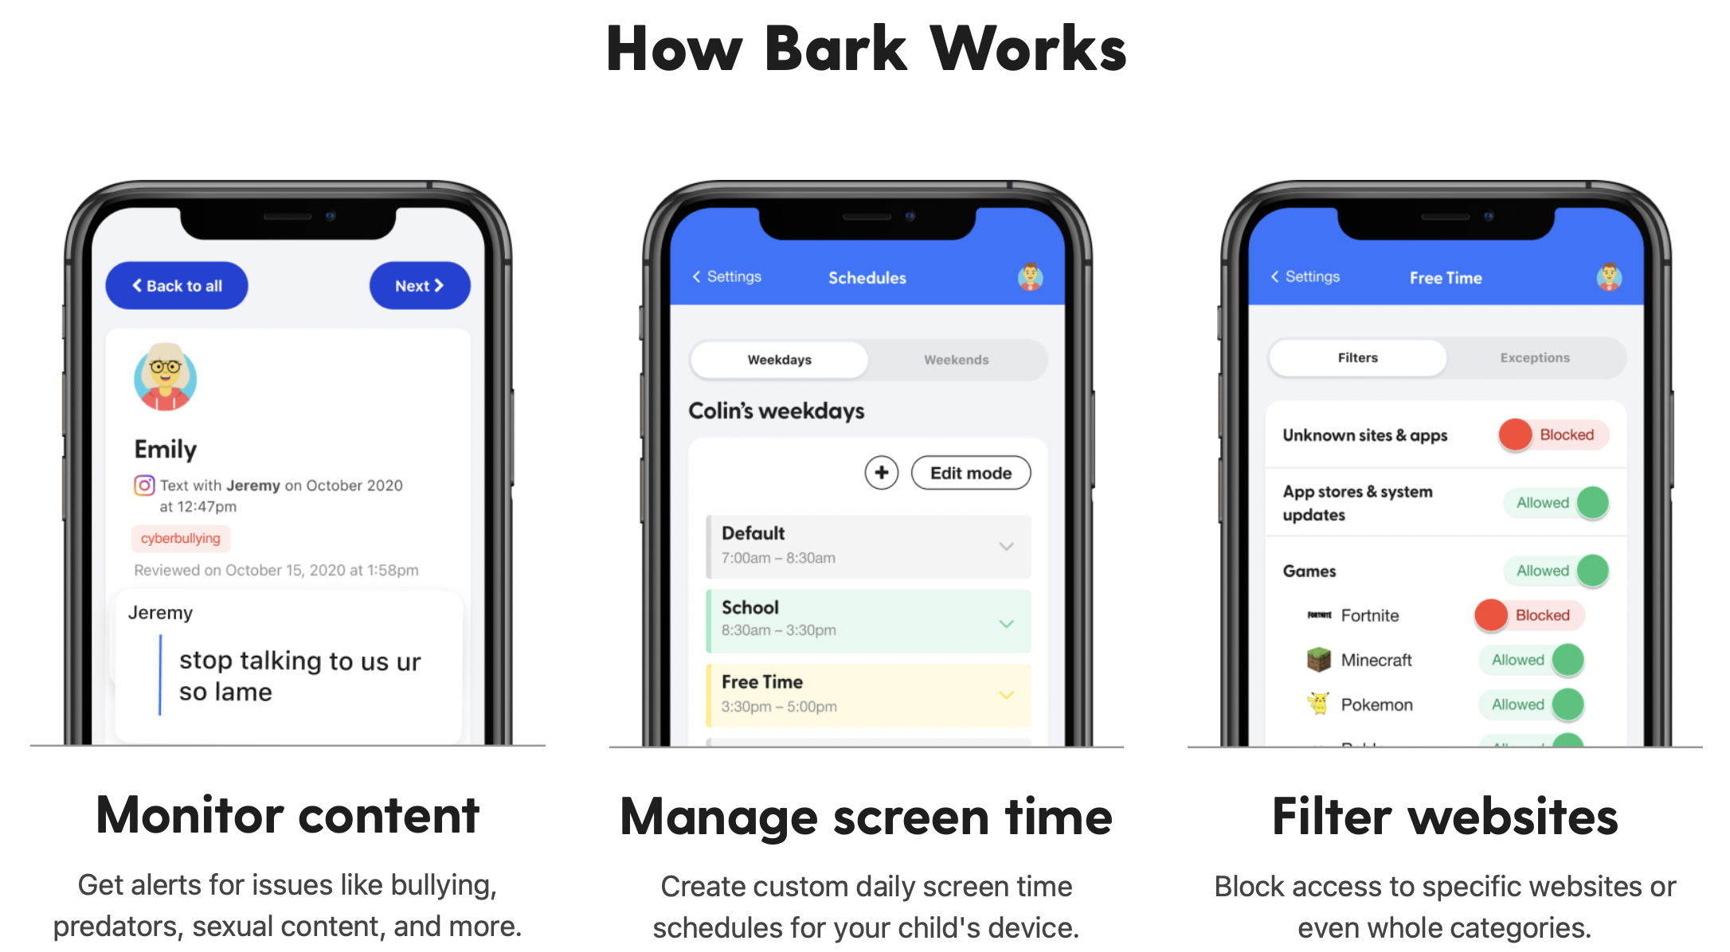

Slide 14
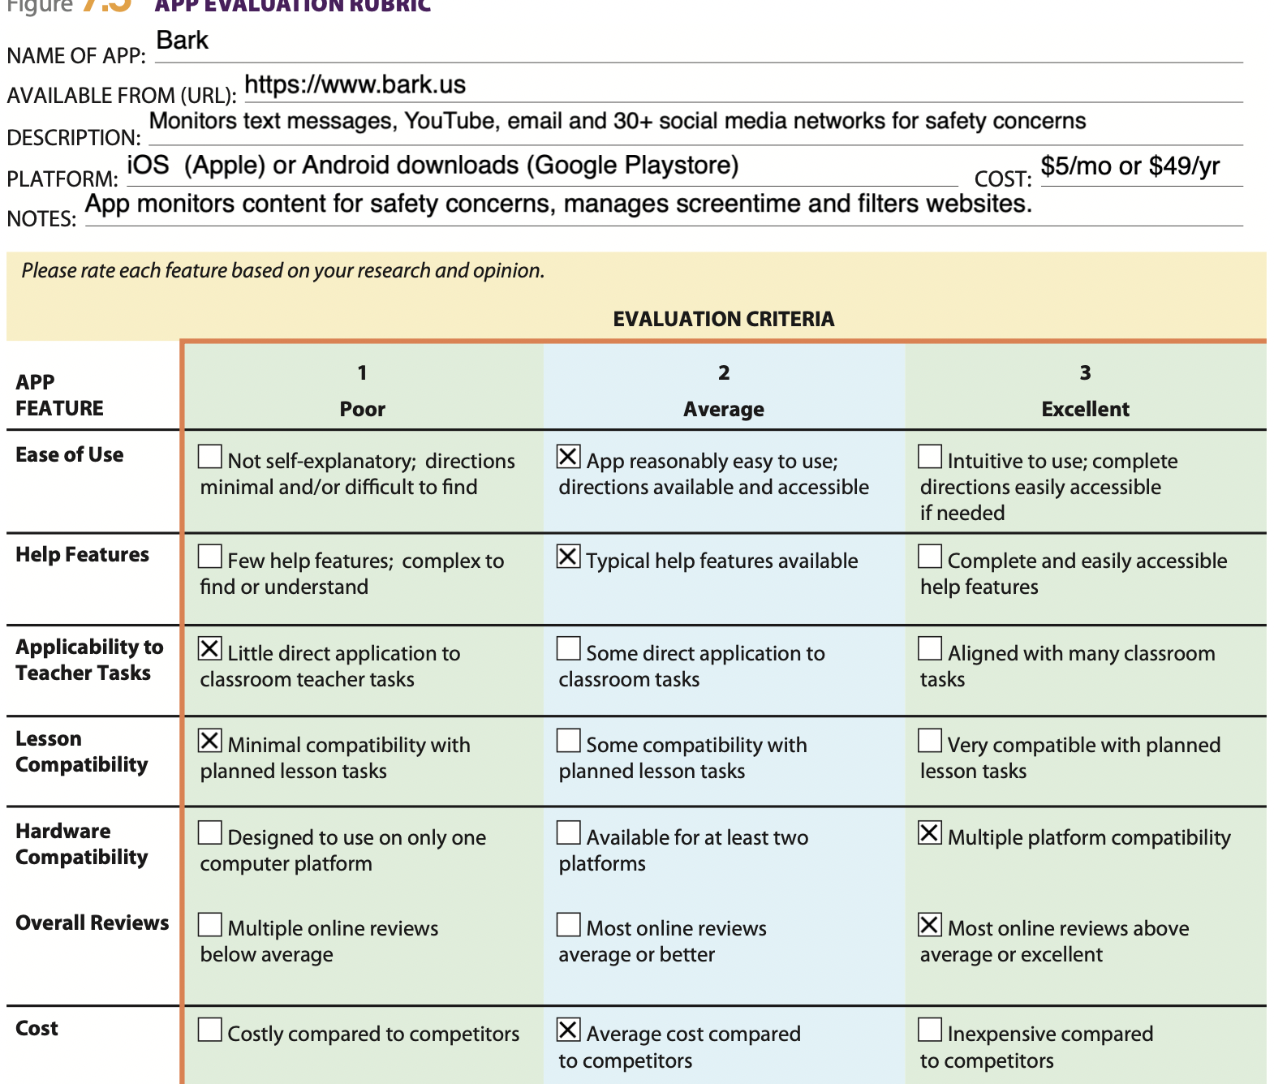

Slide 15
Khan Academy
Nonprofit with the mission to provide a free, world-class education for anyone, everywhere.
Allows parents to “Add a child” to monitor progress of their child.
Offers practice exercise, instructional videos and a personalized learning dashboard.
Study at your own pace
Test preparation
Develop a strong foundation, or review basic concepts

Slide 16
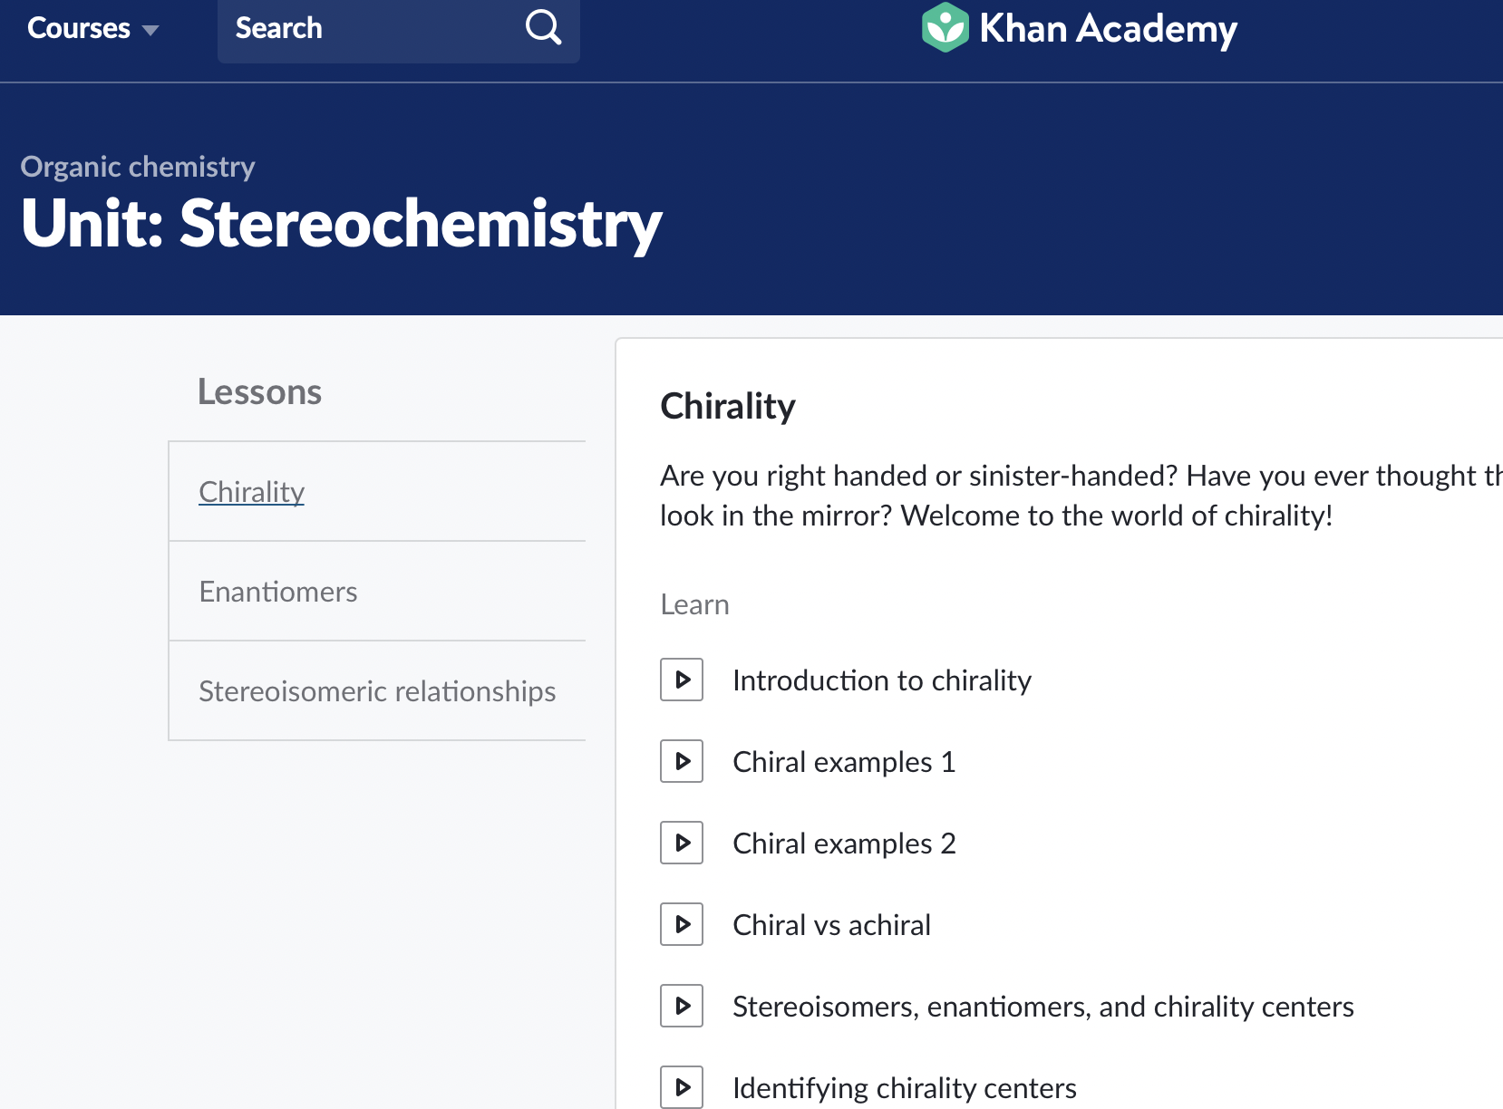
Khan academy, continued.

Slide 17
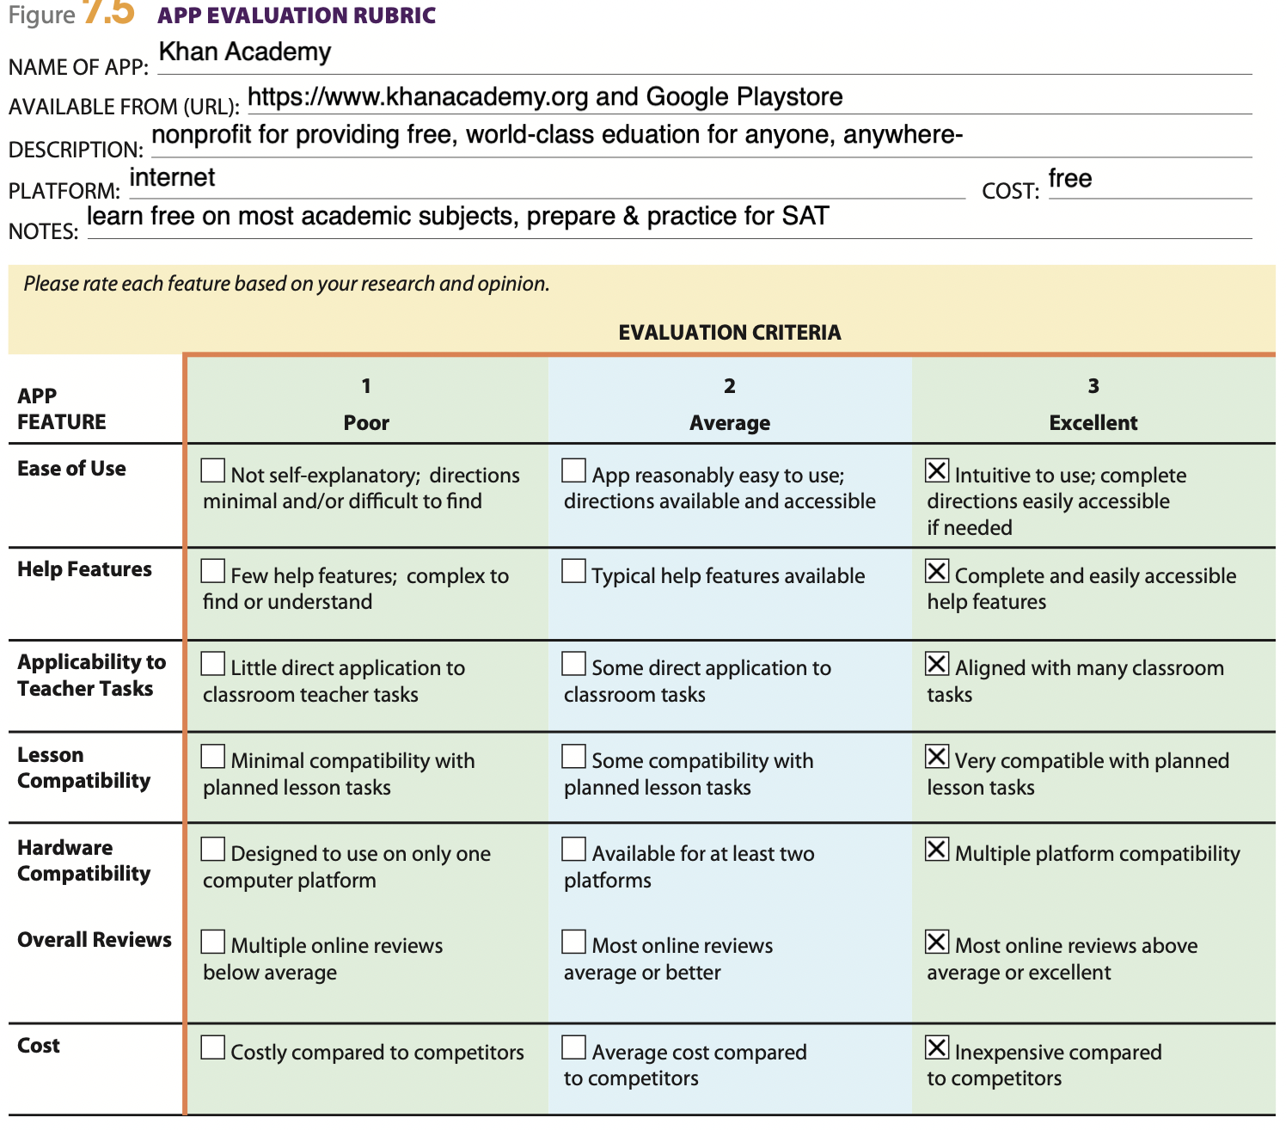

Slide 18
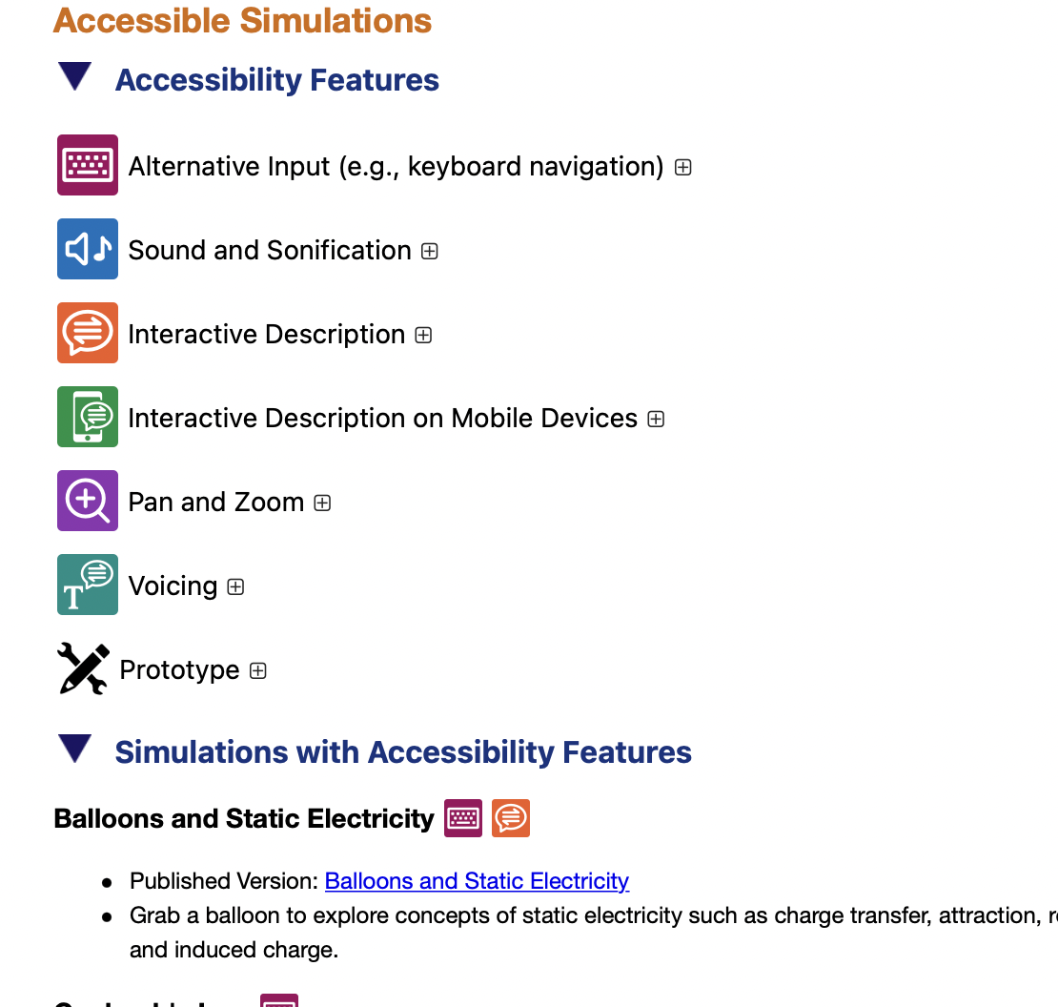
Teacher’s APPs:
1) PhET – Science/math
Notes:
Can use simulations for class, can utilize them for workshops, guided inquiry activities/ workshops/labs, tips and suggestions are donated by professors
Accessible Simulations are available for teachers that need them for various reasons

Slide 19
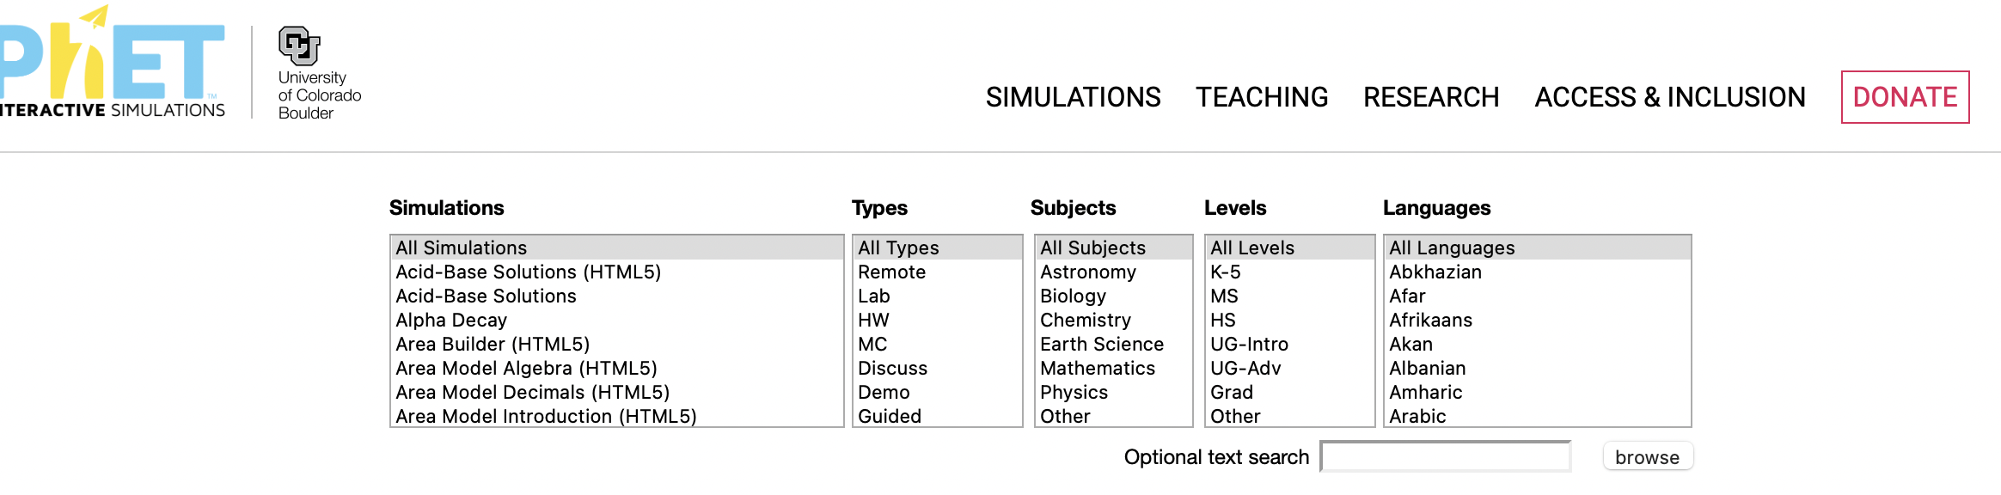
Notes:
There are many teacher-contributed lessons

Slide 21
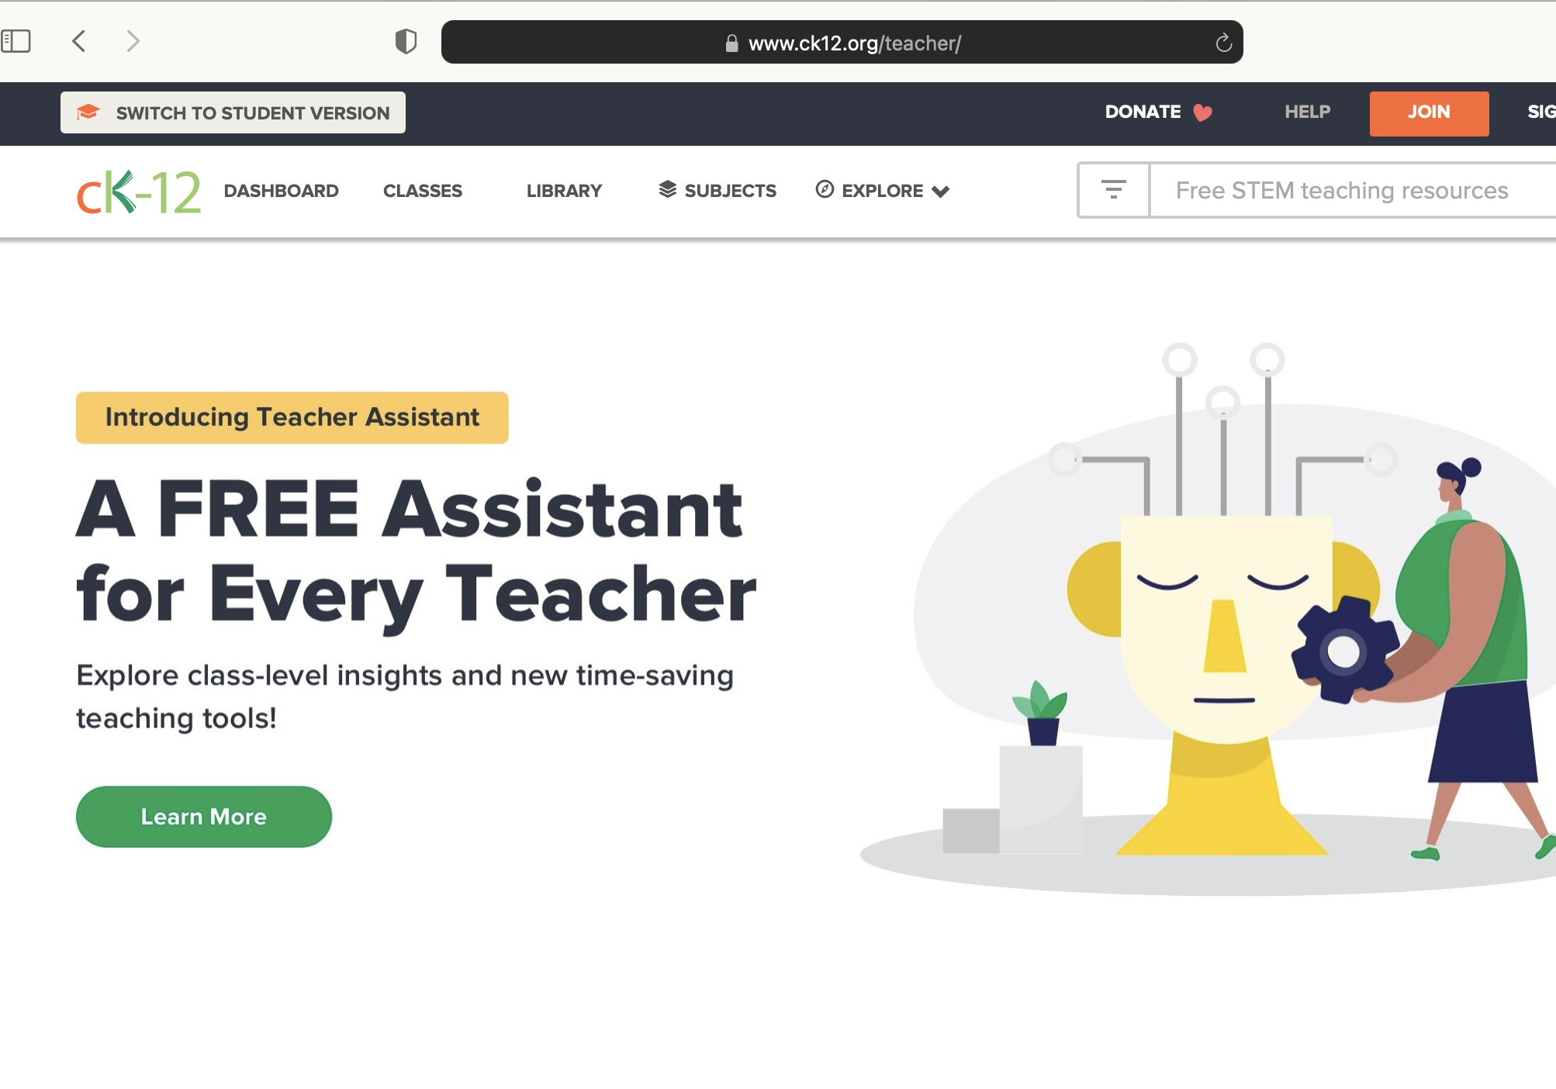
CK-12 Science Resources
Notes:
CK-12 is an online-learning app for Students (Parents) and Teachers.
CK-12 offers a Certified Educator Program, which is self-paced. Parents or Teachers certifiy.
There is a Dashboard for learning on a computer or mobile platform

Slide 22
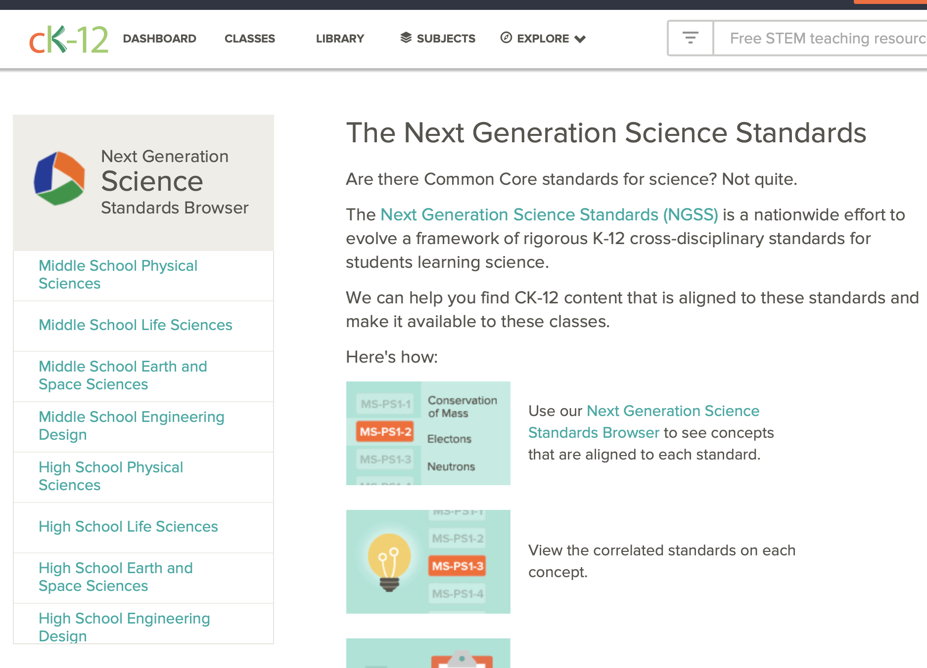

Slide 24
Explain Everything
It’s basically an app for doing presentations, and was started during the pandemic
A whiteboard for online and offline teaching anytime, anywhere

Slide 25
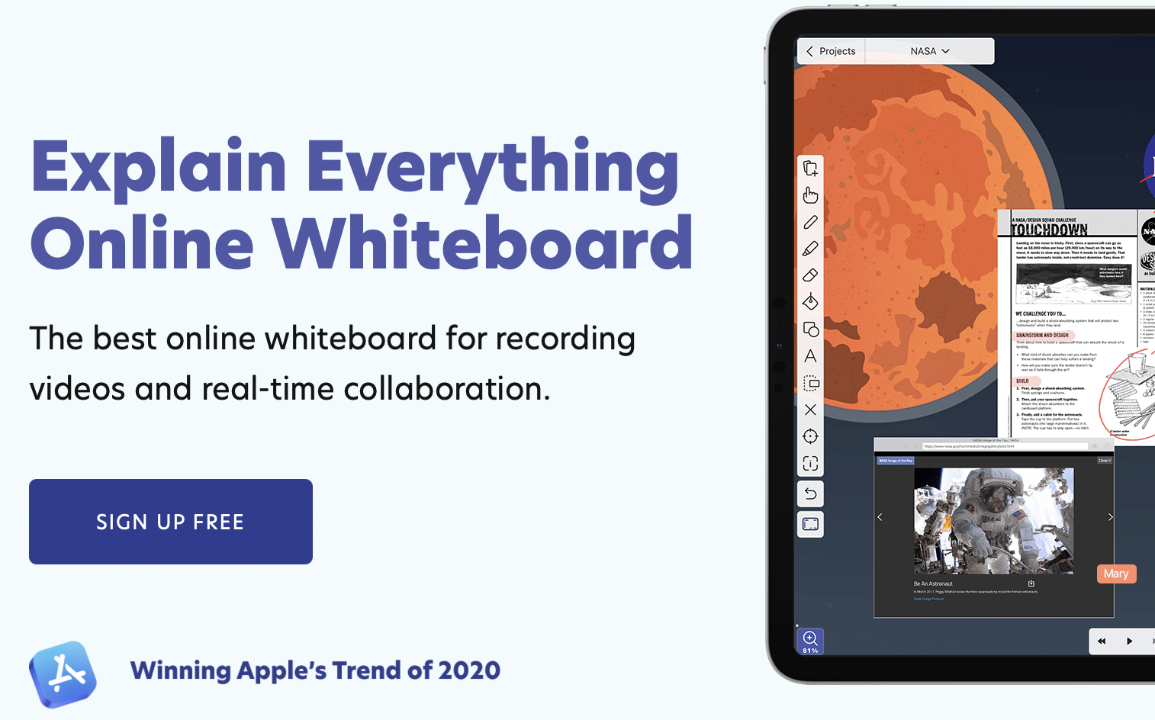
Explain everything

Slide 26
Explain everything
Whiteboard for presentations, online or offline (Platform similar to Blackboard
Collaborative
Webinars
Certification course
Apple or Android mobile app
Free to get started (1 year) and then $25 for one year or $8.99 per user

Slide 27
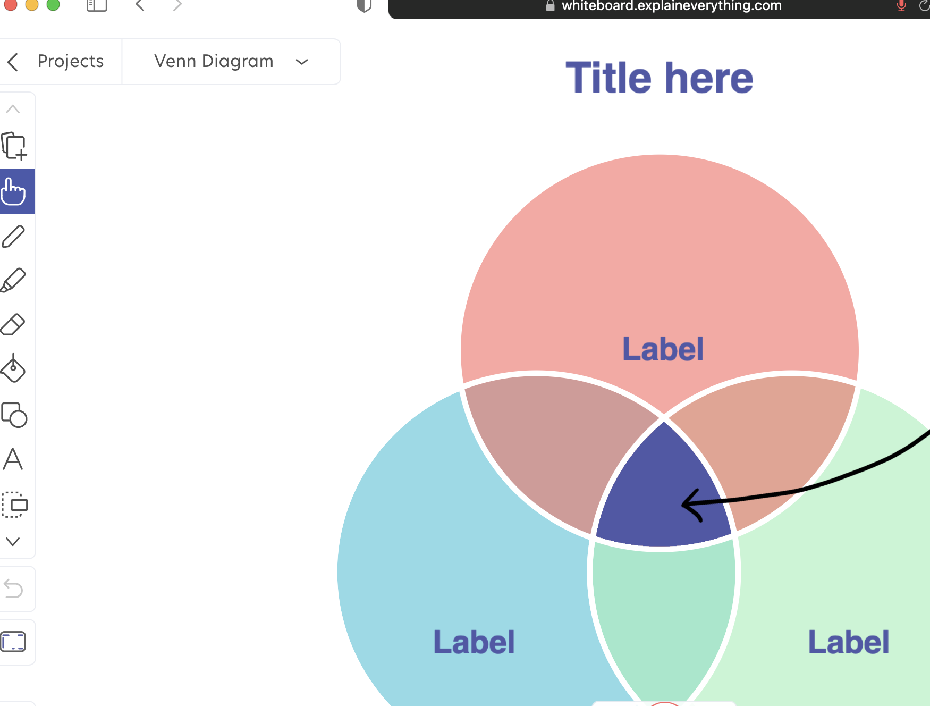

Slide 28
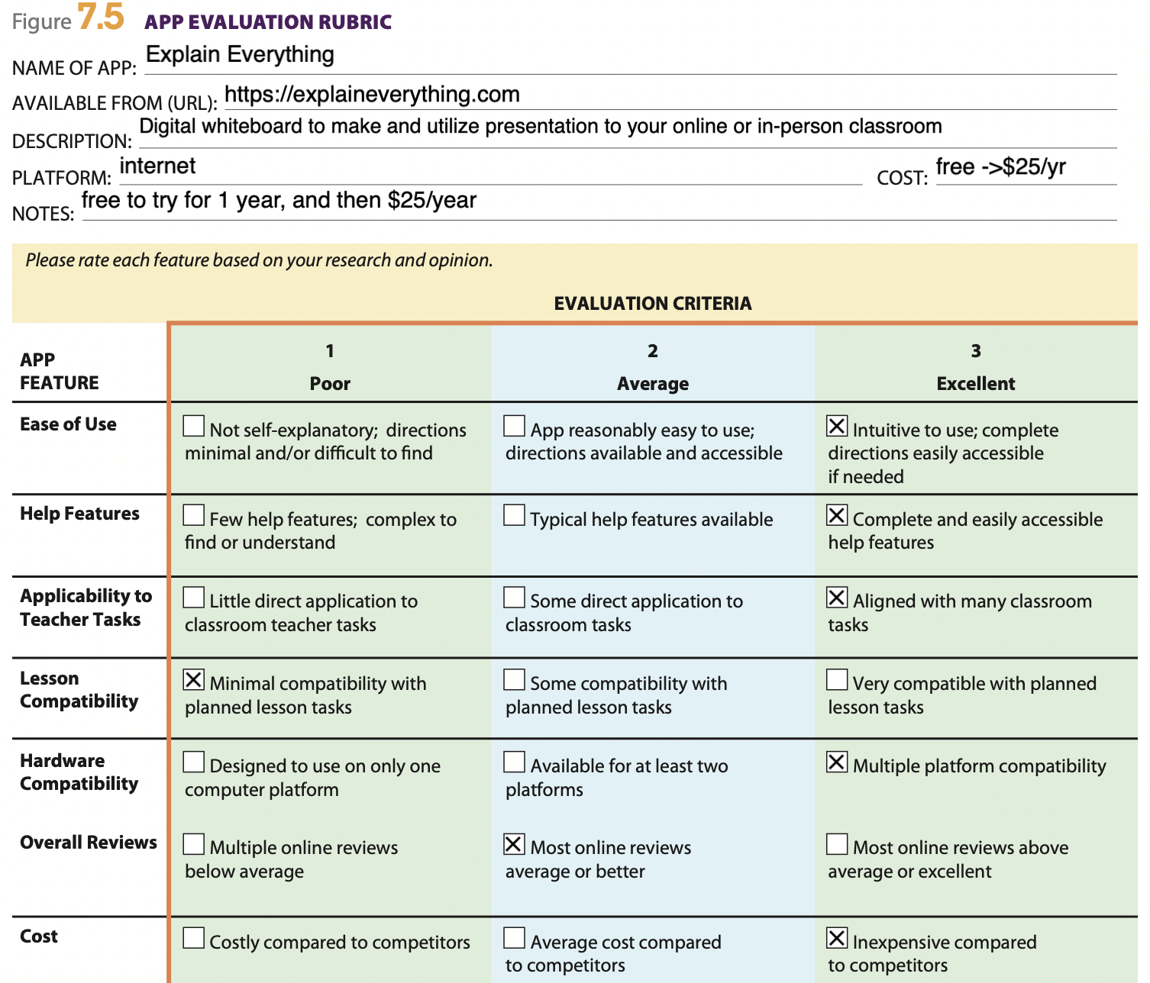

Slide 29

LAbster
Simulations in actual labs

Slide 30

Labster
Search tool for any of 209 simulations on many Science topics

Slide 31


Slide 32
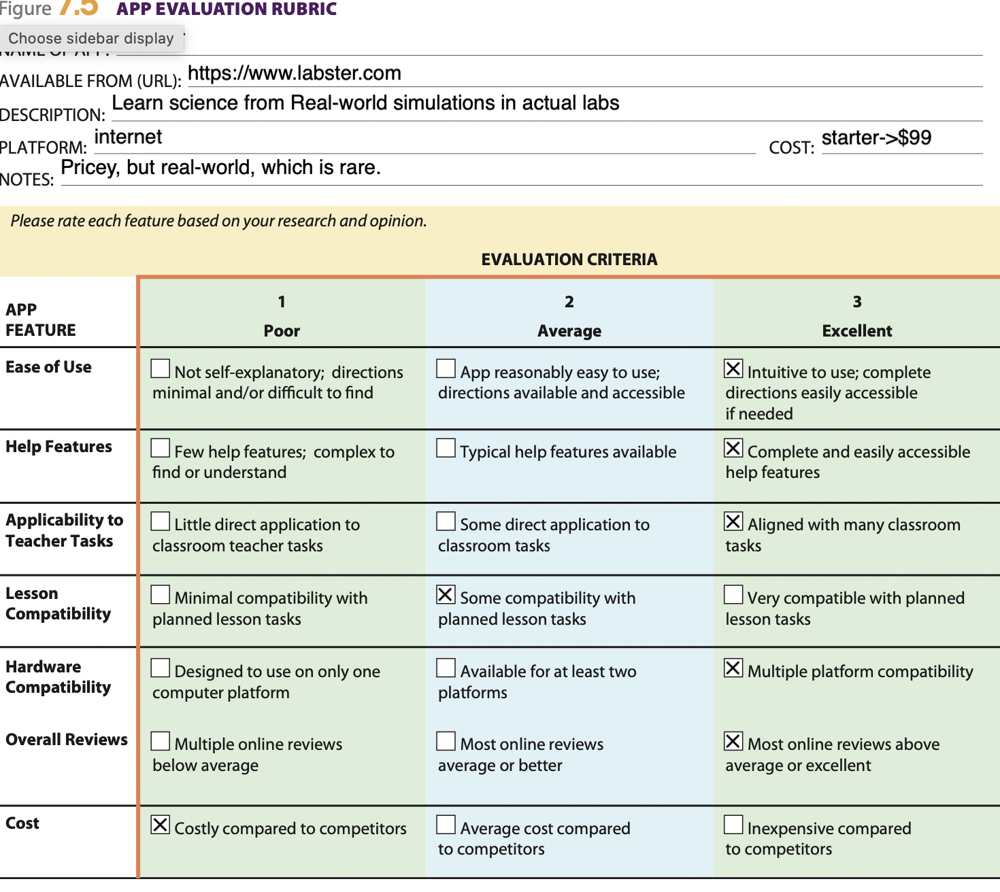

Slide 33
Because Learning!
Designed to improve STEM education inside and out.
Learning resources have the NGSS and local state standards as foundation
100+ customizable lessons
Student worksheets
Expensive, $21/mo, School Site License
Lesson plans, worksheets available

Slide 34

Because Learning!

Slide 35
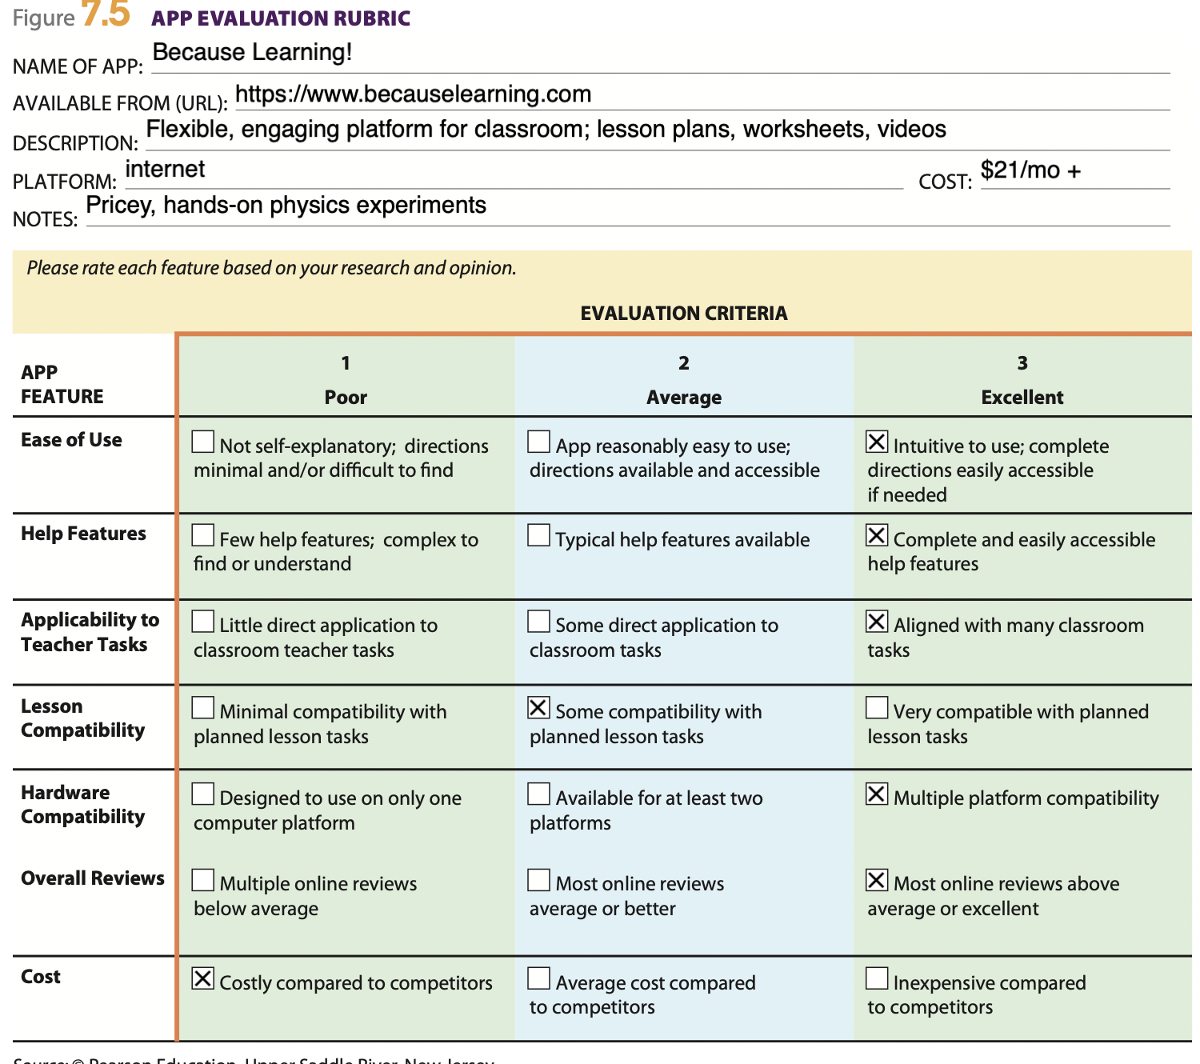

Slide 36
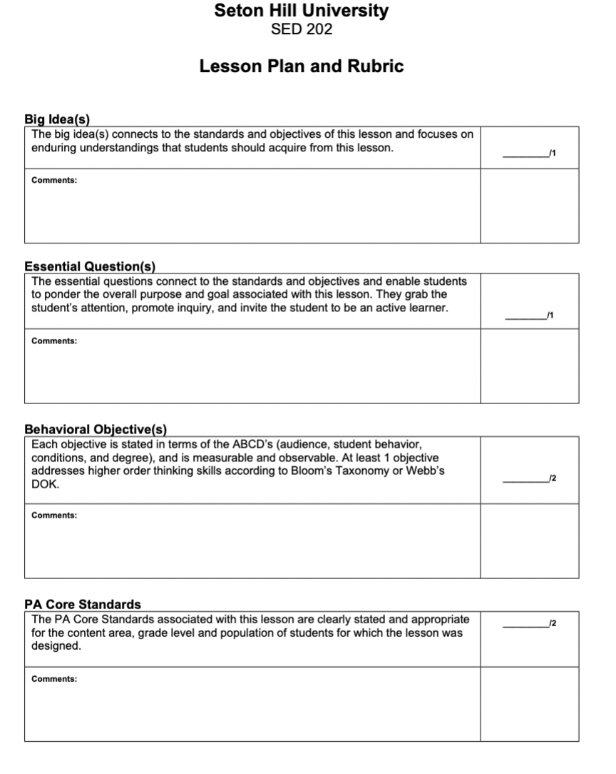
POINT VALUE RUBRIC FOR SCORING THE APPS
BASED ON RUBRIC FOR SETON HILL’s Lesson Plan rubric scale of 1-5 for each category
Notes:
The Point value rubric for scoring the apps was based on the Rubric for Seton Hill’s lesson plan rubric. A scale of 1-5 was used for each categ

Slide 37
Point value scores for Parent apps
Criteria | PhET-Sims | CK-12 | Cyber civics | Khan Academy | Bark
Big idea connects with objectives/standards | 5 | 5 | 3 | 5 | N/A
Students able to form questions-Inquiry based | 5 | 4 | 3 | 3 | N/A
Objectives stated for each ABCD | 5 | 3 | 3 | 3 | N/A
Clear core standards stated for level | 5 | 3 | 3 | 3 | N/A
 | 20 | 15 | 12 | 14 | N/A
Notes:
Based on the Point value scores for student apps, PhET Science/Math Simulations scored the highest, because they had relevant material which was age appropriate, had inquiry based learning material was many different options,
Bark was left out of the scoring because it was not classroom based, but was important to point out for security, parental controls

Slide 38
Point value scores for teacher apps
Criteria | PhET Sims | CK-12 | Explain Everything | Labster | Because Learning!
Big idea connects with objectives/standards | 5 | 4 | 2 | 5 | 3
Students able to form questions-Inquiry based | 4 | 3 | 2 | 5 | 3
Objectives stated for each ABCD | 5 | 4 | 2 | 5 | 4
Clear core standards stated for level | 5 | 2 | O | 3 | 5
totals | 19 | 13 | 6 | 18 | 15
Notes:
PhET Science/Math Simulations scored the highest due to meeting Objectives of teaching and learning standards, inquiry- based learning approach and interesting and fun platform. There were contributions from many teachers.

Slide 39

Best APP in both categories
– parents and teachers
Notes:
The best app in both categories – parents and teachers – was PhET Interactive Simulations

