Slide 1
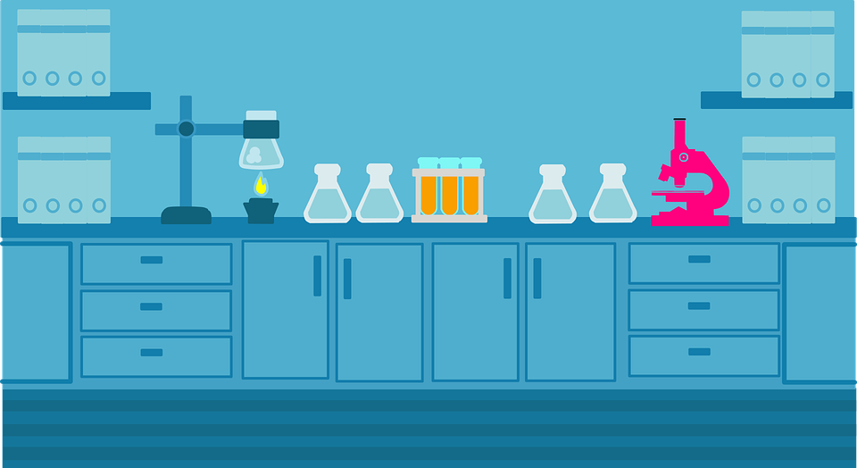



Chemistry Class
For SED 118
Maria K. Ferguson
September 19, 2021

Slide 2


Chemical Reactions for Middle School
Let’s do this!
Watch the video on Chemical reactions, then continue to the next slide.
Watch video
Chemical Equations Introduction
Notes:
As the video suggested, there are many ways that molecules and ions can react. We saw an exothermic reaction, and also an equilibrium reaction.
After watching the video, continue to the next slide for more on the Combustion reaction, and some tutorials on Chemical Reactions.

Slide 3

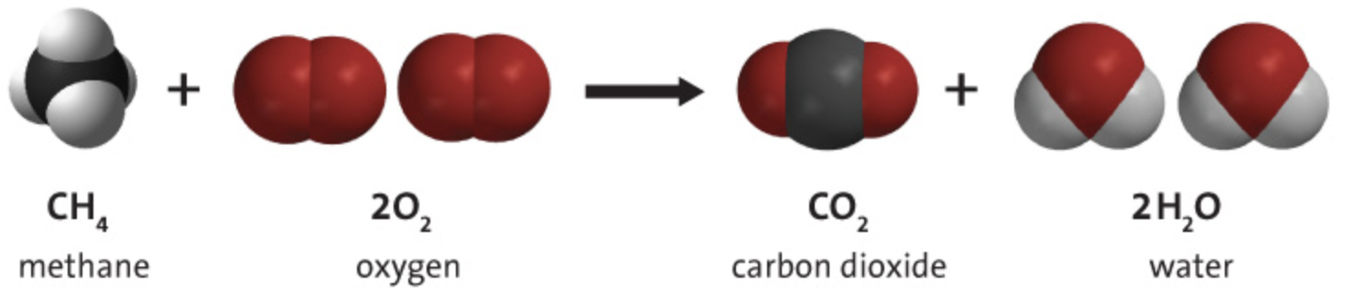

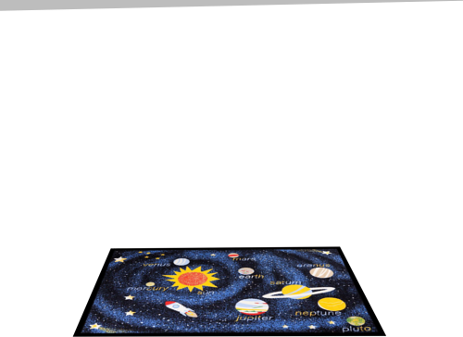
Chemical Reactions for Middle School
Combustion of Methane
Practice balancing equations
Combustion reaction
Notes:
In this reaction, the atoms of the reactants, Methane and Oxygen, come apart and rearrange, then rebond to make the products Carbon dioxide and water. The same number and types of atoms in the reactants are in the products. One molecule of Methane reacts with two molecules of Oxygen to form one molecule of Carbon Dioxide and two molecules of water. For more on balancing equations, click the hyperlink on the shelf and listen to the tutorial.

Slide 4
A physical change, involving a change in state, or dissolving, doesn’t create a new substance, but a chemical change does.
In a chemical reaction, the atoms and molecules that interact are called reactants.
The atoms and molecules produced by the reaction are called products
In a chemical reaction, only the atoms present in the reactants can wind up in the products. No NEW atoms are created and no atoms are destroyed.
In a chemical reaction, reactants contact each other, bonds between the atoms in the reactants are broken and atoms rearrange and form new bonds to make the products
I hope they enjoy the cool video!
Fun Video on combustion of gases
Activity sheet

Slide 5


Chemical Reactions for Middle School
Library
Teacher instructions for Chemical Reactios (ACS)
Standard: Common Core
Next Generation Science Standards

Slide 6
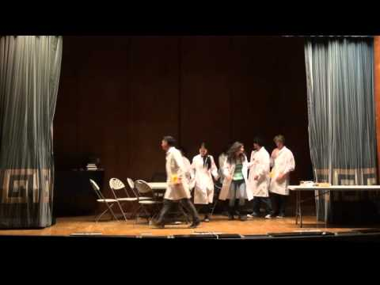
Mystery theater production
- one hour long
High School
Extra Credit
Mystery Activity sheet

Slide 7
